Slide 1
Applied Mechanism Design For Social Good
John P Dickerson
Lecture #4 – 02/06/2020
CMSC828M
Tuesdays & Thursdays
2:00pm – 3:15pm

Slide 2
Wrap up From last class …

Slide 3
Strategies & Utility
A strategy s_{i} for agent i is a mapping of history/the agent’s knowledge of the world to actions
Pure: “perform action x with probability 1”
Randomized: “do x with prob 0.2 and y with prob 0.8”
A strategy set is the set of strategies available to agent i
Can be infinite (infinite number of actions, randomization)
A strategy profile is an instantiation (s₁, s₂, s₃, …, s_{N})
Abuse of notation: we’ll use s_{-i} to refer to all strategies played other than that by agent i
i = 2, then s_{-i} = (s₁, s₃, ..., s_{N})
Utils awarded after game is played: u_{i} = u_{i}(s_{i}, s_{-i})

Slide 4
Example: Chicken
Dodge
Straight
S
D
D
S
D
0, 0 | -1, 1
1, -1 | -5, -5
????????
????????
S
Thankfully, (D, S) and (S, D) are Nash equilibria
They are pure-strategy Nash equilibria: nobody randomizes
They are also strict Nash equilibria: changing your strategy will make you strictly worse off
No other pure-strategy Nash equilibria
VC

Slide 5
Correlated equilibrium
Suppose there is a trustworthy mediator who has offered to help out the players in the game
The mediator chooses a profile of pure strategies, perhaps randomly, then tells each player what her strategy is in the profile (but not what the other players’ strategies are)
A correlated equilibrium is a distribution over pure-strategy profiles so that every player wants to follow the recommendation of the mediator (if she assumes that the others do so as well)
Every Nash equilibrium is also a correlated equilibrium
Corresponds to mediator choosing players’ recommendations independently
… but not vice versa
(Note: there are more general definitions of correlated equilibrium, but it can be shown that they do not allow you to do anything more than this definition.)
VC

Slide 6
C.E. for Chicken
D
S
D
0, 0 | -1, 1
1, -1 | -5, -5
20%
40%
S
40%
0%
Why is this a correlated equilibrium?
Suppose the mediator tells Row to Dodge
From Row’s perspective, the conditional probability that Col was told to Dodge is 20% / (20% + 40%) = 1/3
So the expected utility of Dodging is (2/3)*(-1) = -2/3
But the expected utility of Straight is (1/3)*1 + (2/3)*(-5) = -3
So Row wants to follow the recommendation
If Row is told to go Straight, he knows that Col was told to Dodge, so again Row wants to follow the recommendation
Similar for Col

Slide 7
Does Nash Model Human Behavior?
Game: pick a number (let’s say, integer) in {0, 1, 2, 3, …, 98, 99, 100}
Winner: person who picks number that is closest to 2/3 of the average of all numbers
Example: if the average of all numbers is 54, your best answer would be 36 ( = 54 * 2/3)
LIVE EXPERIMENT!

Slide 8
Does Nash Model Human Behavior?
What’s the (Nash) equilibrium strategy?
“Level 0” humans: everyone picks randomly? E[v] = 50, choose 50 * 2/3
“Level 1” humans: everyone picks 50 * 2/3, I’ll pick (50 * 2/3) * 2/3
“Level 2” humans: I’ll pick ((50 * 2/3) * 2/3) * 2/3 …
N.E.: fixed point, “Level infinity”, pick 0 or 1 depending on constraints

Slide 9
Does Nash Model Human Behavior?
Any guesses on behavior …?

Slide 10
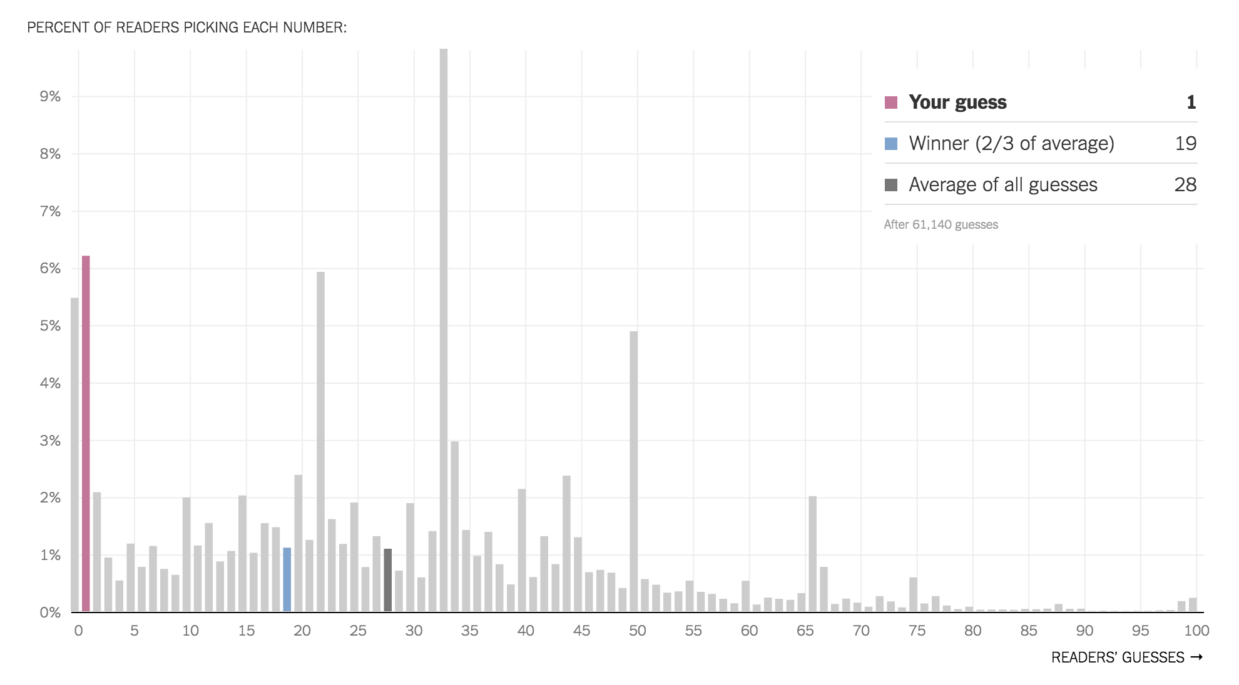
NY Times

Slide 11
This class: Social Choice & Mechanism Design Primer
Thanks to: AGT book, Conitzer (VC), Parkes (DP), Procaccia (AP), Sandholm (TS)

Slide 12
Social choice
A mathematical theory that focuses on aggregation of individuals’ preferences over alternatives, usually in an attempt to collectively choose amongst all alternatives.
A single alternative (e.g., a president)
A vector of alternatives or outcomes (e.g., allocation of money, goods, tasks, jobs, resources, etc)
Agents reveal their preferences to a center
A social choice function then:
aggregates those preferences and picks outcome
Voting in elections, bidding on items on eBay, requesting a specific paper/lecture presentation in CMSC828M, …

Slide 13
Formal Model of voting
Set of voters N and a set of alternatives A
Each voter ranks the alternatives
Full ranking
Partial ranking (e.g., US presidential election)
A preference profile is the set of all voters’ rankings
1 | 2 | 3 | 4
a | b | a | c
b | a | b | a
c | c | c | b

Slide 14
Voting Rules
A voting rule is a function that maps preference profiles to alternatives
Many different voting rules – we’ll discuss more in Nov.
Plurality: each voter’s top-ranked alternative gets one point, the alternative with the most points wins
a: 2 points; b: 1 point; c: 1 point → a wins
1 | 2 | 3 | 4
a | b | a | c
b | a | b | a
c | c | c | b
??????????

Slide 15
Single Transferable Vote
Wasted votes: any vote not cast for a winning alternative
Plurality wastes many votes (US two-party system …)
Reducing wasted votes is pragmatic (increases voter participation if they feel like votes matter) and more fair
Single transferable vote (STV):
Given m alternatives, runs m-1 rounds
Each round, alternative with fewest plurality votes is eliminated
Winner is the last remaining alternative
Ireland, Australia, New Zealand, a few other countries use STV (and coincidentally have more effective “third” parties…)
You might hear this called “instant run-off voting”

Slide 16
STV Example
1 | 2 | 3 | 4 | 5
a | a | b | b | c
b | b | a | a | d
c | c | d | d | b
d | d | c | c | a
Starting preference profile:
1 | 2 | 3 | 4 | 5
a | a | b | b | c
b | b | a | a | b
c | c | c | c | a
Round 1, d has no plurality votes
1 | 2 | 3 | 4 | 5
a | a | b | b | b
b | b | a | a | a
Round 2, c has 1 plurality vote
1 | 2 | 3 | 4 | 5
b | b | b | b | b
Round 3, a has 2 plurality votes
AP

Slide 17
Manipulation: Agenda paradox
Preference profile:
x > z > y (35%)
y > x > z (33%)
z > y > x (32%)
Binary protocol (majority rule), aka “cup”
Three types of agents:
x
y
x
z
y
z
x
z
y
z
x
y
z
y
y
x
z
x
Power of agenda setter (e.g., chairman)
Under plurality rule, x wins
Under STV rule, y wins
TS
Notes:
“Cup” as in a tournament cup

Slide 18
How should we design voting rules?
Take an axiomatic approach!
Majority consistency:
If a majority of people vote for x as their top alternative, then x should win the election
Is plurality majority consistent?
Yes
Is STV majority consistent?
No
Is cup majority consistent?
No

Slide 19
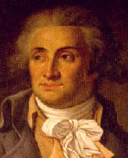
How should we design voting rules?
Given a preference profile, an alternative is a Condorcet winner if it beats all other alternatives in pairwise elections
Wins plurality vote against any candidate in two-party election
Doesn’t always exist! Condorcet Paradox:
x > y (2-1); y > z (2-1); z > x (2-1) → x > y > z > x
Condorcet consistency: chooses Condorcet winner if it exists
Stronger or weaker than majority consistency …?
1 | 2 | 3
x | z | y
y | x | z
z | y | x
Notes:
Marquis de Condorcet – one of the leaders of the French revolution (18th century), died in prison after the revolution – probably should’ve tried a better voting rule

Slide 20
How should we design voting rules?
Strategyproof: voters cannot benefit from lying.
Is it computationally tractable to determine winner?
Unanimous: if all voters have the same preference profile, then the aggregate ranking equals that.
(Non-)dictatorial: is there a voter who always gets her preferred alternative?
Independence of irrelevant alternatives (IIA): social preference between any alternatives a and b only depends on the voters’ preferences between a and b.
Onto: any alternative can win
Gibbard-Satterthwaite (1970s): if |A| > 3, then any voting rule that is strategyproof and onto is a dictatorship.
Notes:
IIA: if the voting rule ranks a above b for the current set of votes, and then we change the votes but do not change which is ahead between a and b in each vote … then a should still be ranked ahead of b.

Slide 21
Computational Social Choice
There are many strong impossibility results like G-S
We will discuss more of them (e.g., G-S, Arrow’s Theorem) during the voting theory lectures in a month and a half
Computational social choice creates “well-designed” implementations of social choice functions, with an eye toward:
Computational tractability of the winner determination problem
Communication complexity of preference elicitation
Designing the mechanism to elicit preferences truthfully
Interactions between these can lead to positive theoretical results and practical circumventions of impossibility results.

Slide 22
Mechanism Design: Model
Before: we were given preference profiles
Reality: agents reveal their (private) preferences
Won’t be truthful unless it’s in their individual interest; but
We want some globally good outcome
Formally:
Center’s job is to pick from a set of outcomes O
Agent i draws a private type θ_{i} from Θ_{i}, a set of possible types
Agent i has a public valuation function v_{i} : Θ_{i} x O → ℜ
Center has public objective function g : Θ x O → ℜ
Social welfare max aka efficiency, maximize g = Σ_{i} v_{i}(θ_{i}, o)
Possibly plus/minus monetary payments

Slide 23
Mechanism Design Without Money
A (direct) deterministic mechanism without payments o maps Θ → O
A (direct) randomized mechanism without payments o maps Θ → Δ(O), the set of all probability distributions over O
Any mechanism o induces a Bayesian game, Game(o)
A mechanism is said to implement a social choice function f if, for every input (e.g., preference profile), there is a Nash equilibrium for Game(o) where the outcome is the same as f

Slide 24
Pictorially …
Agents draw private types θ from Θ
If those types were known, an outcome f(θ) would be chosen
Instead, agents send messages M (e.g., report their type as θ’, or bid if we have money) to the mechanism
Goal: design a mechanism whose Game induces a Nash equilibrium where the outcome equals f(θ)
Θ
O
θ
f(θ)
NE(M, Game, θ)
M, Game
Notes:
Stanley Reiter diagram.

Slide 25
A (Silly) Mechanism that does not implement welfare max
2 agents, 1 item
Each agent draws a private valuation for that item
Social welfare maximizing outcome: agent with greatest private valuation receives the item.
Mechanism:
Agents send a message of {1, 2, …, 10}
Item is given to the agent who sends the lowest message; if both send the same message, agent i = 1 gets the item
Equilibrium behavior: ??????????
Always send the lowest message (1)
Outcome: agent i = 1 gets item, even if i = 2 values it more

Slide 26
Mechanism Design With Money
We will assume that an agent’s utility for
her type being θ_{i},
outcome o being chosen,
and having to pay π_{i},
can be written as v_{i}(θ_{i}, o) - π_{i}
Such utility functions are called quasilinear
“quasi” – linear with respect to one of the raw inputs, in this case payment π_{i}, as well as a function of the rest (i.e., v_{i}(θ_{i}, o))
Then, (direct) deterministic and randomized mechanisms with payments additionally specify, for each agent i, a payment function π_{i} : Θ → ℜ
VC

Slide 27
Vickrey’s Second Price Auction Isn’t manipulable
(Sealed) bid on single item, highest bidder wins & pays second-highest bid price
1
Bid θ_{i}’ > θ_{i} and win:
Second-highest bid θ_{j}’ > θ_{i} ?
Payment is θ_{j}’, pay more than valuation!
Second-highest bid θ_{j}’ < θ_{i} ?
Payment from bidding truthfully is the same
Bid θ_{i}’ > θ_{i} and lose: same outcome as truthful bidding
Bid θ_{i}’ < θ_{i} and win: same outcome as truthful bidding
Bid θ_{i}’ < θ_{i} and lose:
Winning bid θ_{j}’ > θ_{i} ?
Wouldn’t have won by bidding truthfully, either
Winning bid θ_{j}’ < θ_{i} ?
Bidding truthfully would’ve given positive utility
Bid value θ_{i}’
Other bid θ_{j}’
True value θ_{i}
Bid value θ_{i}’
0

Slide 28
The Clarke (aka VCG) mechanism
The Clarke mechanism chooses some outcome o that maximizes Σ_{i} v_{i}(θ_{i}’, o)
To determine the payment that agent j must make:
Pretend j does not exist, and choose o_{-j} that maximizes Σ_{i≠j} v_{i}(θ_{i}’, o_{-j})
j pays Σ_{i≠j} v_{i}(θ_{i}’, o_{-j}) - Σ_{i≠j} v_{i}(θ_{i}’, o) = = Σ_{i≠j} ( v_{i}(θ_{i}’, o_{-j}) - v_{i}(θ_{i}’, o) )
We say that each agent pays the externality that she imposes on the other agents
Agent i’s externality: (social welfare of others if i were absent) - (social welfare of others when i is present)
(VCG = Vickrey, Clarke, Groves)
VC

Slide 29
Incentive compatibility
Incentive compatibility: there is never an incentive to lie about one’s type
A mechanism is dominant-strategies incentive compatible (aka strategyproof) if for any i, for any type vector θ₁, θ₂, …, θ_{i}, …, θ_{n}, and for any alternative type θ_{i}’, we have
v_{i}(θ_{i}, o(θ₁, θ₂, …, θ_{i}, …, θ_{n})) - π_{i}(θ₁, θ₂, …, θ_{i}, …, θ_{n}) ≥
v_{i}(θ_{i}, o(θ₁, θ₂, …, θ_{i}’, …, θ_{n})) - π_{i}(θ₁, θ₂, …, θ_{i}’, …, θ_{n})
A mechanism is Bayes-Nash equilibrium (BNE) incentive compatible if telling the truth is a BNE, that is, for any i, for any types θ_{i}, θ_{i}’,
Σ_{θ-i} P(θ_{-i}) [v_{i}(θ_{i}, o(θ₁, θ₂, …, θ_{i}, …, θ_{n})) - π_{i}(θ₁, θ₂, …, θ_{i}, …, θ_{n})] ≥
Σ_{θ-i} P(θ_{-i}) [v_{i}(θ_{i}, o(θ₁, θ₂, …, θ_{i}’, …, θ_{n})) - π_{i}(θ₁, θ₂, …, θ_{i}’, …, θ_{n})]
VC

Slide 30
VCG is strategyproof
Total utility for agent j is
v_{j}(θ_{j}, o) - Σ_{i≠j} ( v_{i}(θ_{i}’, o_{-j}) - v_{i}(θ_{i}’, o) )
= v_{j}(θ_{j}, o) + Σ_{i≠j} v_{i}(θ_{i}’, o) - Σ_{i≠j} v_{i}(θ_{i}’, o_{-j})
But agent j cannot affect the choice of o_{-j}
→ j can focus on maximizing v_{j}(θ_{j}, o) + Σ_{i≠j} v_{i}(θ_{i}’, o)
But mechanism chooses o to maximize Σ_{i} v_{i}(θ_{i}’, o)
Hence, if θ_{j}’ = θ_{j}, j’s utility will be maximized!
Extension of idea: add any term to agent j’s payment that does not depend on j’s reported type
This is the family of Groves mechanisms
VC

Slide 31
Individual rationality
A selfish center: “All agents must give me all their money.” – but the agents would simply not participate
This mechanism is not individually rational
A mechanism is ex-post individually rational if for any i, for any known type vector θ₁, θ₂, …, θ_{i}, …, θ_{n}, we have
v_{i}(θ_{i}, o(θ₁, θ₂, …, θ_{i}, …, θ_{n})) - π_{i}(θ₁, θ₂, …, θ_{i}, …, θ_{n}) ≥ 0
A mechanism is ex-interim individually rational if for any i, for any type θ_{i},
Σ_{θ-i} P(θ_{-i}) [v_{i}(θ_{i}, o(θ₁, θ₂, …, θ_{i}, …, θ_{n})) - π_{i}(θ₁, θ₂, …, θ_{i}, …, θ_{n})] ≥ 0
Is the Clarke mechanism individually rational?
VC
Notes:
Ex-ante: before any agents see their types
Ex-interim: after I’ve seen my type, but I haven’t seen your types
Ex-post: I know my type and I know your types

Slide 32
Why only truthful direct-revelation mechanisms?
Bob has an incredibly complicated mechanism in which agents do not report types, but do all sorts of other strange things
Bob: “In my mechanism, first agents 1 and 2 play a round of rock-paper-scissors. If agent 1 wins, she gets to choose the outcome. Otherwise, agents 2, 3 and 4 vote over the other outcomes using the STV voting rule. If there is a tie, everyone pays $100, and …”
Bob: “The equilibria of my mechanism produce better results than any truthful direct revelation mechanism.”
Could Bob be right?
VC

Slide 33



The revelation principle
For any (complex, strange) mechanism that produces certain outcomes under strategic behavior (dominant strategies, BNE)…
… there exists a {dominant-strategies, BNE} incentive compatible direct-revelation mechanism that produces the same outcomes!
new mechanism
P₁
types
actions
mechanism
P₂
outcome
P₃
VC
Notes:
(1) We start with some arbitrary mechanism M that implements a social welfare function
Replace each player with a simulator – these will compute, given a player’s type, her best strategy in M
New direct mechanism M’ just asks for types, feeds into simulators, produces same outcome

Slide 34
revelation principle in practice
“Only direct mechanisms needed”
But: strategy formulator might be complex
Complex to determine and/or execute best-response strategy
Computational burden is pushed on the center (i.e., assumed away)
Thus the revelation principle might not hold in practice if these computational problems are hard
This problem traditionally ignored in game theory
But: even if the indirect mechanism has a unique equilibrium, the direct mechanism can have additional bad equilibria
TS

Slide 35
revelation principle As an analysis tool
Best direct mechanism gives tight upper bound on how well any indirect mechanism can do
Space of direct mechanisms is smaller than that of indirect ones
One can analyze all direct mechanisms & pick best one
Thus one can know when one has designed an optimal indirect mechanism (when it is as good as the best direct one)

Slide 36
computational issues in mechanism design
Algorithmic mechanism design
Sometimes standard mechanisms are too hard to execute computationally (e.g., Clarke requires computing optimal outcome)
Try to find mechanisms that are easy to execute computationally (and nice in other ways), together with algorithms for executing them
Automated mechanism design
Given the specific setting (agents, outcomes, types, priors over types, …) and the objective, have a computer solve for the best mechanism for this particular setting
When agents have computational limitations, they will not necessarily play in a game-theoretically optimal way
Revelation principle can collapse; need to look at nontruthful mechanisms
Many other things (computing the outcomes in a distributed manner; what if the agents come in over time (online setting); …) – many good project ideas here ☺.
VC, AGT

Slide 37
Running Example: Mechanism Design for Kidney Exchange

Slide 38
The players and their incentives
Clearinghouse cares about global welfare:
How many patients received kidneys (over time)?
Transplant centers care about their individual welfare:
How many of my own patients received kidneys?
Patient-donor pairs care about their individual welfare:
Did I receive a kidney?
(Most work considers just clearinghouse and centers)

Slide 39
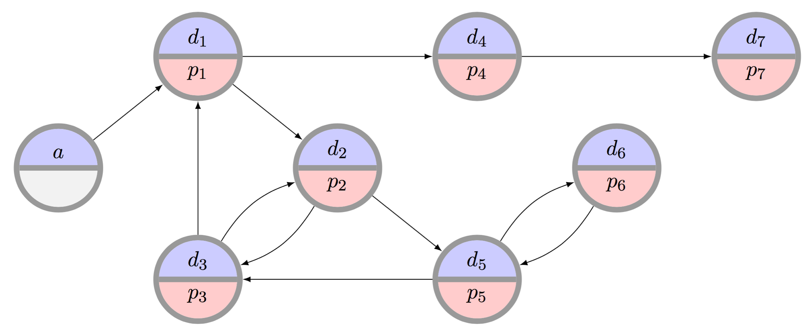
Private vs Global Matching

Slide 40
Modeling the problem
What is the type of an agent?
What is the utility function for an agent?
What would it mean for a mechanism to be:
Strategyproof
Individually rational
Efficient

Slide 41
Known Results
Theory [Roth&Ashlagi 14, Ashlagi et al. 15, Toulis&Parkes 15]:
Can’t have a strategy-proof and efficient mechanism
Can get “close” by relaxing some efficiency requirements
Even for the undirected (2-cycle) case:
No deterministic SP mechanism can give 2-eps approximation to social welfare maximization
No randomized SP mechanism can give 6/5-eps approx
But! Ongoing work by a few groups hints at dynamic models being both more realistic and less “impossible”!
Reality: transplant centers strategize like crazy! [Stewert et al. 13]

Slide 42
Next class: Combinatorial Optimization Also: Email me about presenting!

